Slide 1
JOURNAL CLUB PRESENTATION 1.12024
1st year presenter – dr yahya
2nd year presenter – dr vrshni
Registrar IN CHARGE – dr cheong kw
Lecturer in charge – dr Othman puteh

Slide 2
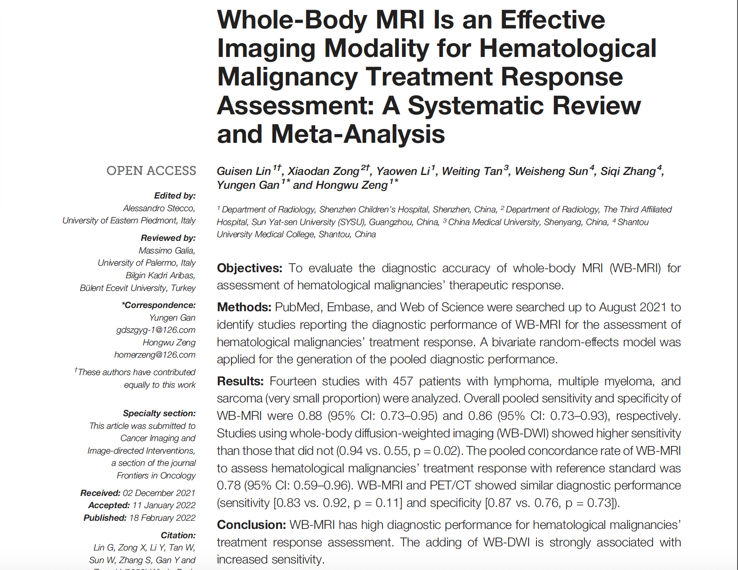

Slide 3
INTRODUCTION
Assessment of cancer treatment response can help the clinicians to decide on to continue or change the treatment strategy.
This is achieved by assessing the tumor size as well as monitoring metabolic changes before or after treatment.
Mostly by using F-FDG PET/CT imaging

Slide 4
However recently, WB-MRI has been increasingly used as the clinical tool as it can:
Used for cancer staging and screening
It shows great potential for assessing therapeutic response of cancer
It can detect restricted proton diffusion when combined with WB-DWI

Slide 5
However, there are controversial in using WB-MRI as surrogate imaging modality:
Some scholars reported WB-MRI had comparable result for treatment assessment with PET/CT while others reported an inferior performance
Correlation between tumor metabolism changes and diffusion is controversial
So, the aim of this study was to perform a systematic review and meta-analysis to evaluate the diagnostic value of WB-MRI for assessment of hematological malignancy treatment response.

Slide 6
LITERATURE SEARCH
PubMed, Embase and Web of Science were searched to identify studies exploring diagnostic value of WB-MRI for cancer treatment response.
Search was focused on these following phrases: whole-body magnetic resonance imaging, whole-body MRI, WB-MRI, Whole-body diffusion weighted imaging, Whole body DWI, WB-DWI, treatment response, therapeutic response and response assessment.

Slide 7
STUDY SELECTION
Inclusion criteria of the reviewed articles include:
1) treatment response assessment of any type of hematological malignancies using WB-MRI with or without WB-DWI
2) article written in English.
The exclusion criteria as follows:
1. study with data insufficient to calculate true positive (TP), true negative (TN), false positive (FP), and false negative (FN) for construction of a 2 x 2 contingency table
2. assessment of treatment response using automatic methods or texture analysis
3. assessment of metastatic cancers without assessing the primary cancer
4. treatment response assessment of a previously treated cancer.

Slide 8
DATA EXTRACTION AND QUALITY ASSESSMENT
Patients with complete response (CR) and partial response (PR) as a response to treatment, while progressive disease (PD) and stable disease (SD) were defined as treatment failure.
True positive (TP) defined as the true prediction of response to treatment.
False positive (FP) defined as the false prediction of response to treatment.
True negative (TN) defined as the true prediction of treatment failure.
False negative (FN) defined as the false prediction of treatment failure.

Slide 9
STATISTICAL ANALYSIS
Possible cause of heterogeneity was analyzed using meta-regression.
Univariate meta-regression conducted initially. If more than 1 factor identified associated with heterogeneity through univariate meta-regression, multivariate meta-regression including all identified factors were done subsequently.
Multilevel mixed-effects logistics regression used to compare diagnostic performance of WB-MRI with PET/CT for assessing treatment response with a significant level of p < 0.05

Slide 10
QUALITY ASSESSMENT, HETEROGENEITY & PUBLICATION BIAS
Majority of the studies had high quality with a low risk of bias except one study which had high risk of bias and high concern of applicability for the index test since the threshold for the apparent diffusion coefficient (ADC) value to differentiate treatment response was not pre-specific.
Another study had an unclear risk of bias and concern of applicability for the index test since it did not indicate whether the WB-MRI was interpreted without knowledge of the results of the reference standard.

Slide 11
Whole-Body MRI Versus PET/CT for Cancer Treatment Response Assessment and Contrast-Enhanced Versus Non Contrast-Enhanced Whole-Body MRI for Lymphoma Treatment Response Assessment
6 studies were chosen for the comparison of diagnostic performance between WB-MRI and PET/CT for cancer treatment assessment. There were no significant difference either for sensitivity or specificity.
For treatment assessment of lymphoma, contrast-enhanced WB-MRI was applied in 2 studies and rest 4 studies conducted without contrast-enhanced sequences.
Contrast-enhanced WB-MRI had higher sensitivity but similar specificity for lymphoma treatment assessment as compared to non-enhanced WB-MRI.

Slide 12
DISCUSSION
This is the first meta-analysis to evaluate the diagnostic performance of WB-MRI for hematological malignancies therapeutic response assessment.
WB-MRI had a relatively high sensitivity and specificity for therapeutic response assessment in patients with lymphoma, multiple myeloma, and sarcoma.
Concordance rate of WB-MRI compared with the reference standard revealed a moderately high concordance rate of 78%.
These indicate that WB-MRI is an effective imaging modality for assessing treatment response in patients with lymphoma, multiple myeloma, and sarcoma.

Slide 13
DISCUSSION
Studies with WB-DWI showed a significantly higher sensitivity for cancer treatment assessment than those without.
DWI is a multipotent imaging modality for cancer diagnosis, staging, and treatment response assessment.
Additionally ADC helps identify non-responder lesions for Hodgkin lymphoma after a few courses of chemotherapy.
Increase of ADC value was due to loss of cellularity caused by effective treatment. Therefore, the adding of WB-DWI may increase the sensitivity for the assessment of cancer treatment response.

Slide 14
DISCUSSION
Contrast-enhanced WB-MRI for assessment of lymphoma therapeutic response has increased sensitivity but similar specificity as compared to unenhanced WB-MRI.
Dynamic contrast-enhanced MRI improved the accuracy for detection of splenic involvement of Hodgkin lymphoma.
WB-MRI gaining attention in the field of pediatric oncology due to the following reasons:
zero dose of ionizing radiation (particularly important as their organs are more radiosensitive)
WB-MRI could provide high-quality imaging of the entire body within 1 h

Slide 15
DISCUSSION
This meta-analysis shows that WB-MRI, especially combined with WB-DWI is a promising imaging tool for treatment response assessment in widely disseminated malignancies such as multiple myeloma, lymphoma, and sarcoma.
However there are some drawbacks to WB-MRI
quantitative assessment of treatment response beyond the mere size evaluation on WB-MRI is still challenging.
no consensus on WB-MRI scanning protocols and ADC value thresholds for the assessment of treatment response
miscalculation of ADC measurements may hamper the correct evaluation of ADC values of lymph nodes, particularly in the mediastinum, which is a very common location of lymphoma.

Slide 16
DISCUSSION
PET/CT has a prognostic role in hematological malignancies, especially in Hodgkin lymphoma where a PET driven therapy is routinely accepted and performed using FDG uptake to understand the tumor’s chemosensitivity.
Limitations to this meta-analysis
significant heterogeneity while generating the diagnostic parameters, which might decrease the general applicability of the pooled estimates. However upon identifying the cause of the heterogeneity the importance of applying WB-DWI in WB-MRI for cancer treatment response assessment was proven to be useful.
composition of the patient population was heterogeneous, with most patients with hematogenic tumors and a small number of patients with sarcoma.
only included studies written in English.

Slide 17
CONCLUSION
WB-MRI has good sensitivity and specificity for the evaluation of the treatment response of multiple myeloma, lymphoma, and sarcoma.
Adding WB-DWI would further increase the sensitivity.
WB-MRI may have comparable performance with PET/CT for therapeutic response assessment, which is particularly attractive in the field of pediatric oncology.

