Slide 1
Journal Club 15.1.24
Phase 1: DR MOHD RUSLI SULAIMAN Phase 2 : DR ABU HANIFAH BIN IBRAHIM Registrar: DR ABDUL HADI BIN SHAMSUL BAHRIN Radiologist: DR MOHD AZAAD A.HAMID

Slide 3
Chronic kidney disease (CKD)
IRREVERSIBLE, PROGRESSIVE LOSS OF KIDNEY FUNCTION
RESULTS IN WIDESPREAD TISSUE SCARRING, LEADS TO DESTRUCTION OF KIDNEY PARENCHYMA AND ESRF.
CAUSED BY:
HYPERTENSION
DIABETES MELLITUS
PRIMARY RENAL DISORDER
PREVALENCE CKD REQUIRING RENAL REPLACEMENT THERAPY (RRT) USA: 340000 (2005) → 651000 (2010) MALAYSIA: (2005) → (2014) 34767 *2.5 FOLD INCREASED*

Slide 4
Conventional usg:
Safe, easy, inexpensive
Can assess parenchymal echogenicity, renal size, parenchymal thickness
Parenchymal echogenicity (commonly used marker) → subjective, not quantitative, thus, uninformative in evaluating the progression of ckd.
Serum creatinine:
Calculate estimated glomerular filtration rate (egfr) to divide into 5 severity-based stages
Egfr may become inconsistent and misleading in:
Acute changes in kidney function
High dietary protein intake
EXTREME body size
SEVERE liver disease
Renal biopsy:
Gold standard for assessing fibrosis with histopathological technique
Invasive
Post biopsy complication

Slide 5
Shear wave elastography Emerging usg technique used to measure tissue STIFFNESS
Real-time short-duration acoustic push pulse is used to generate shear waves that propagate perpendicular to the main ultrasound beam
Waves hit the targeted tissue, the tissue is ‘pushed’ in the direction of propagation causing it to temporarily deform or displace
The ultrasound scanner can monitor the tissue displacement, measuring the time-to-peak displacement and the recovery time
*Shear wave velocity increases in diseased tissues (stiffer than normal one)

Slide 6
Several nephrology studies have UTILISED SWE TO EVALUATE RENAL PARENCHYMAL ELASTICITY, HOWEVER yielded conflicting results
HASSAN ET AL → CORTICAL STIFFNESS WAS INVERSELY CORRELATED WITH EGFR
BOB ET AL, CUI ET AL, HASSAN ET AL → HAVE DEFINED OPTIMAL CUT-OFF VALUES FOR THEIR CONTROL GROUPS, THEIR SAMPLE SIZES WERE RELATIVELY SMALL
THIS STUDY AIM TO INVESTIGATE WHETHER SWE-DERIVED ESTIMATES OF TISSUE YOUNG’S MODULUS (YM) COULD BE USED AS AN INDICATOR TO DISTINGUISH BETWEEN NORMAL AND ABNORMAL RENAL PARENCHYMAL TISSUE, COMPARED WITH USING CONVENTIONAL ULTRASOUND

Slide 7
METHOD AND MATERIALS

Slide 8
Patient Selection
Data were obtained from 309 adults (167 males, 142 females, mean age 55), who had been referred to the Department of Biomedical Imaging, University of Malaya Medical Centre, from July 2016 to August 2017 for routine conventional abdominal ultrasound.
The control group comprised 203 subjects (104 males, 99 females) who did not have any clinical signs of renal disease.

Slide 9
Control Group
Inclusion Criteria
eGFR of >90 (ml min^{–1} /1.73 m²)
serum creatinine of 44–71 μmol l⁻¹
serum urea of 3.2–8.2 mmol l⁻¹
^{Exclusion Criteria}
thin renal parenchymal thickness
renal cortex to skin surface depth of more than 8 cm
those who refused to participate
those who could not control their breathing according to the sonographer's instructions during the SWE procedure

Slide 10
CKD Group
106 patients (63 males, 43 females) receiving treatment at the Nephrology Clinic, Department of Medicine, University of Malaya Medical Centre.
Inclusion criteria (minimum of 2 simultaneously):
abnormal eGFR (<90 ml^{–1} min/1.73 m²)
deranged serum creatinine (>71 μmol l⁻¹)
deranged serum urea (>8.2 mmol l⁻¹)
Exclusion criteria
thin renal parenchymal thickness
renal cortex to skin surface depth of more than 8 cm
those who refused to participate
those who could not control their breathing according to the sonographer's instructions during the SWE procedure

Slide 11
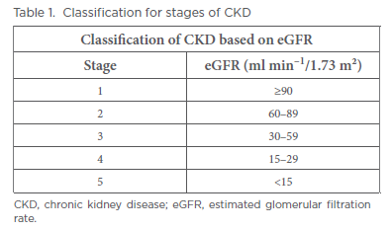
The eGFR values (ml min^{–1} /1.73 m²) were calculated using the CKD Epidemiology Collaboration equation.

Slide 12
Image Acquisition
Patients were placed in a lateral decubitus position.
Bipolar length and cortical thickness of the kidneys were measured.
The long diameter of the kidney was determined as the maximum longitudinal dimension in coronal section.
Kidney cortical thickness was measured from the outer border of the renal cortex to the outer border of the medullary pyramid.
Difference between CKD subgroups
Conventional ultrasound and SWE imaging using an ultrasound scanner (Epiq 7, Philips, Bothell, Washington) equipped with SWE software (ElastPQ, Philips, Bothell, Washington).
Curved array transducer (C5-1, frequency range: 1.0–5.0 MHz)
Examinations done by same sonographer ( 10 years experience)

Slide 13
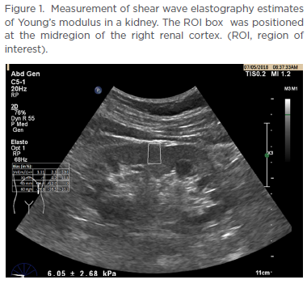
To measure SWE estimates of renal YM in kPa
Using the ElastPQ software, imaging was focused on the long axis view of the kidneys with the transducer placed parallel, without any pressure.
The patients were told to hold their breath (to stabilised image).
A region of interest (ROI) with a fixed size of 0.5 × 0.8 × 0.02 cm3 was placed in the renal cortex, excluding the renal medulla and sinus
Effective stiffness values were measured five consecutive times at the midregion of the kidneys on each side, with shear wave travel oriented perpendicular to the radially arranged tubular system.
The mean value for each kidney was recorded

Slide 14
Intra- and interobserver reliability
31 subjects from the control group participated
SWE imaging was performed by the first sonographer (LSS, 10 years experience) and then repeated by a second sonographer (SM, 5 years experience) on the same day.
Both sonographers were blinded to each other’s SWE imaging results.
Each subject was scanned repeatedly by both sonographers with a 2 day interval to avoid recall bias.
Pre- and post-void studies
31 subjects from the control group participated
SWE imaging was performed on the subjects with a full bladder.
Each subject was examined again on the same day after bladder emptying.
Stiffness values were measured five times at the midregion of the kidneys during pre- and post-void studies.
SWE imaging were performed by LSS
Influence of ROI location on YM measurements
31 patients from the diseased group participated.
Once the stiffness values were acquired in the midregion of the kidneys,
a repeat SWE imaging was performed at the upper pole of the kidneys, orienting the shear wave travel path parallel to the radially arranged tubular system.
SWE imaging were performed by LSS

Slide 15
Statistical Analysis
Type of test | Intention
One-way analysis of variance and Tukey post hoc test. | Analysed mean YM, renal length and parenchymal thickness among diseased and control groups
Pearson’s correlation coefficient (p ≤ 0.05) | Analysed correlations between SWE and conventional ultrasound parameters with age, serum creatinine, eGFR and serum urea
Receiver operating characteristic (ROC) curves | To assessed the diagnostic performance of SWE imaging and conventional ultrasound in distinguishing the diseased group from the control group
Intraclass correlation coefficients (ICCs) | To evaluate the intra- and interobserver reliability of the YM measurements
Paired t-test | To assess YM measurements for the preand post-void study
Wilcoxon rank sum test | To assess YM measurement at different ROI locations.
Data analysis was done using SPSS.
Continuous data were expressed as the mean (+- standard deviation).
The optimal cut-off values for the prediction of the control group was chosen to maximise the sum of sensitivity and specificity.
Notes:
tests were performed on the data collected and significance
levels were declared at p ≤ 0.05. The degree of agreement was quantified as either poor (ICC
< 0.40), fair to good (ICC 0.40–0.75) or excellent (ICC > 0.75)

Slide 16
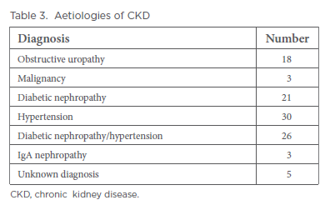
Result
Patient and control subject characteristics
The demographic features of patients and control subjects at different stages of renal function based on eGFR as well as the aetiology of CKD are presented in Tables 2 and 3.
Notes:
A total of 309 adults comprises 106 patients and 203
control subjects were assessed.

Slide 17
2. Relationship between SWE and conventional ultrasound measurements with age, creatinine and urea levels
Moderate negative linear correlation between YM measurements and eGFR (r = −0.576, p < 0.0001).
Weak positive linear correlations between YM measurements with age (r = 0.321, p < 0.0001), serum creatinine (r = 0.375, p < 0.0001) and serum urea (r = 0.287, p < 0.0001) were observed.
Kidney length and cortical thickness obtained sonographically showed no significant correlation with age, eGFR, serum creatinine or serum urea.
No significant difference in renal length or cortical thickness in the diseased and control groups
Significant difference were found between YM measurement with renal length and cortical thickness (F = 90.188, p < 0.0001).
Tukey post hoc test revealed that the YM measurements were lower in the group that had higher eGFR with difficulty to distinguish between CKD 3, 4 and 5 the large variance within the groups.
3. Comparison between SWE imaging with conventional ultrasound
The area under the ROC curve for SWE (0.87) was larger.
YM measurement cut-off value of 4.31 kPa, of which a value less or equal to this suggested a non-diseased kidney
This yielded a sensitivity and specificity of 80.3% and 79.5%, respectively
Notes:
Tukey post hoc test revealed that the YM measurements were lower in the group that had higher eGFR with difficulty to distinguish between CKD 3, 4 and 5 the large variance within the groups.
The area under the ROC curve for SWE (0.87) was larger than that of kidney length and cortical thickness measured using conventional ultrasound
(Table 4). We obtained a YM measurement cut-off value of 4.31 kPa, of which a value less or equal to this suggested a non-diseased kidney.
This yielded a sensitivity and specificity of 80.3% and 79.5%, respectively

Slide 18
4. Reproducibility of YM measurements.
YM measurements had fair to good interobserver reliability and excellent intraobserver reliability.
5. YM measurements from pre- and post-void study.
No significant difference in YM measurements of the renal cortices between empty and full bladder states
6. YM measurements from different ROI location.
Significant median difference of YM measurements between upper pole and midregion ROI box locations (p < 0.0001), with the upper pole (2.52kPa) showing lower YM values than the midregion of the kidney (6.57 kPa)
Notes:
The ICC of the first and second readers were 0.839 [95% confidence interval (CI): 0.734–0.903) and 0.758 (95% CI:
0.600–0.854), respectively. For interobserver reliability, the ICC was 0.687 (95% CI: 0.473–0.807).
A paired-sample t-test showed that there was no significant difference in YM measurements of the renal cortices between empty and full bladder states.

Slide 19
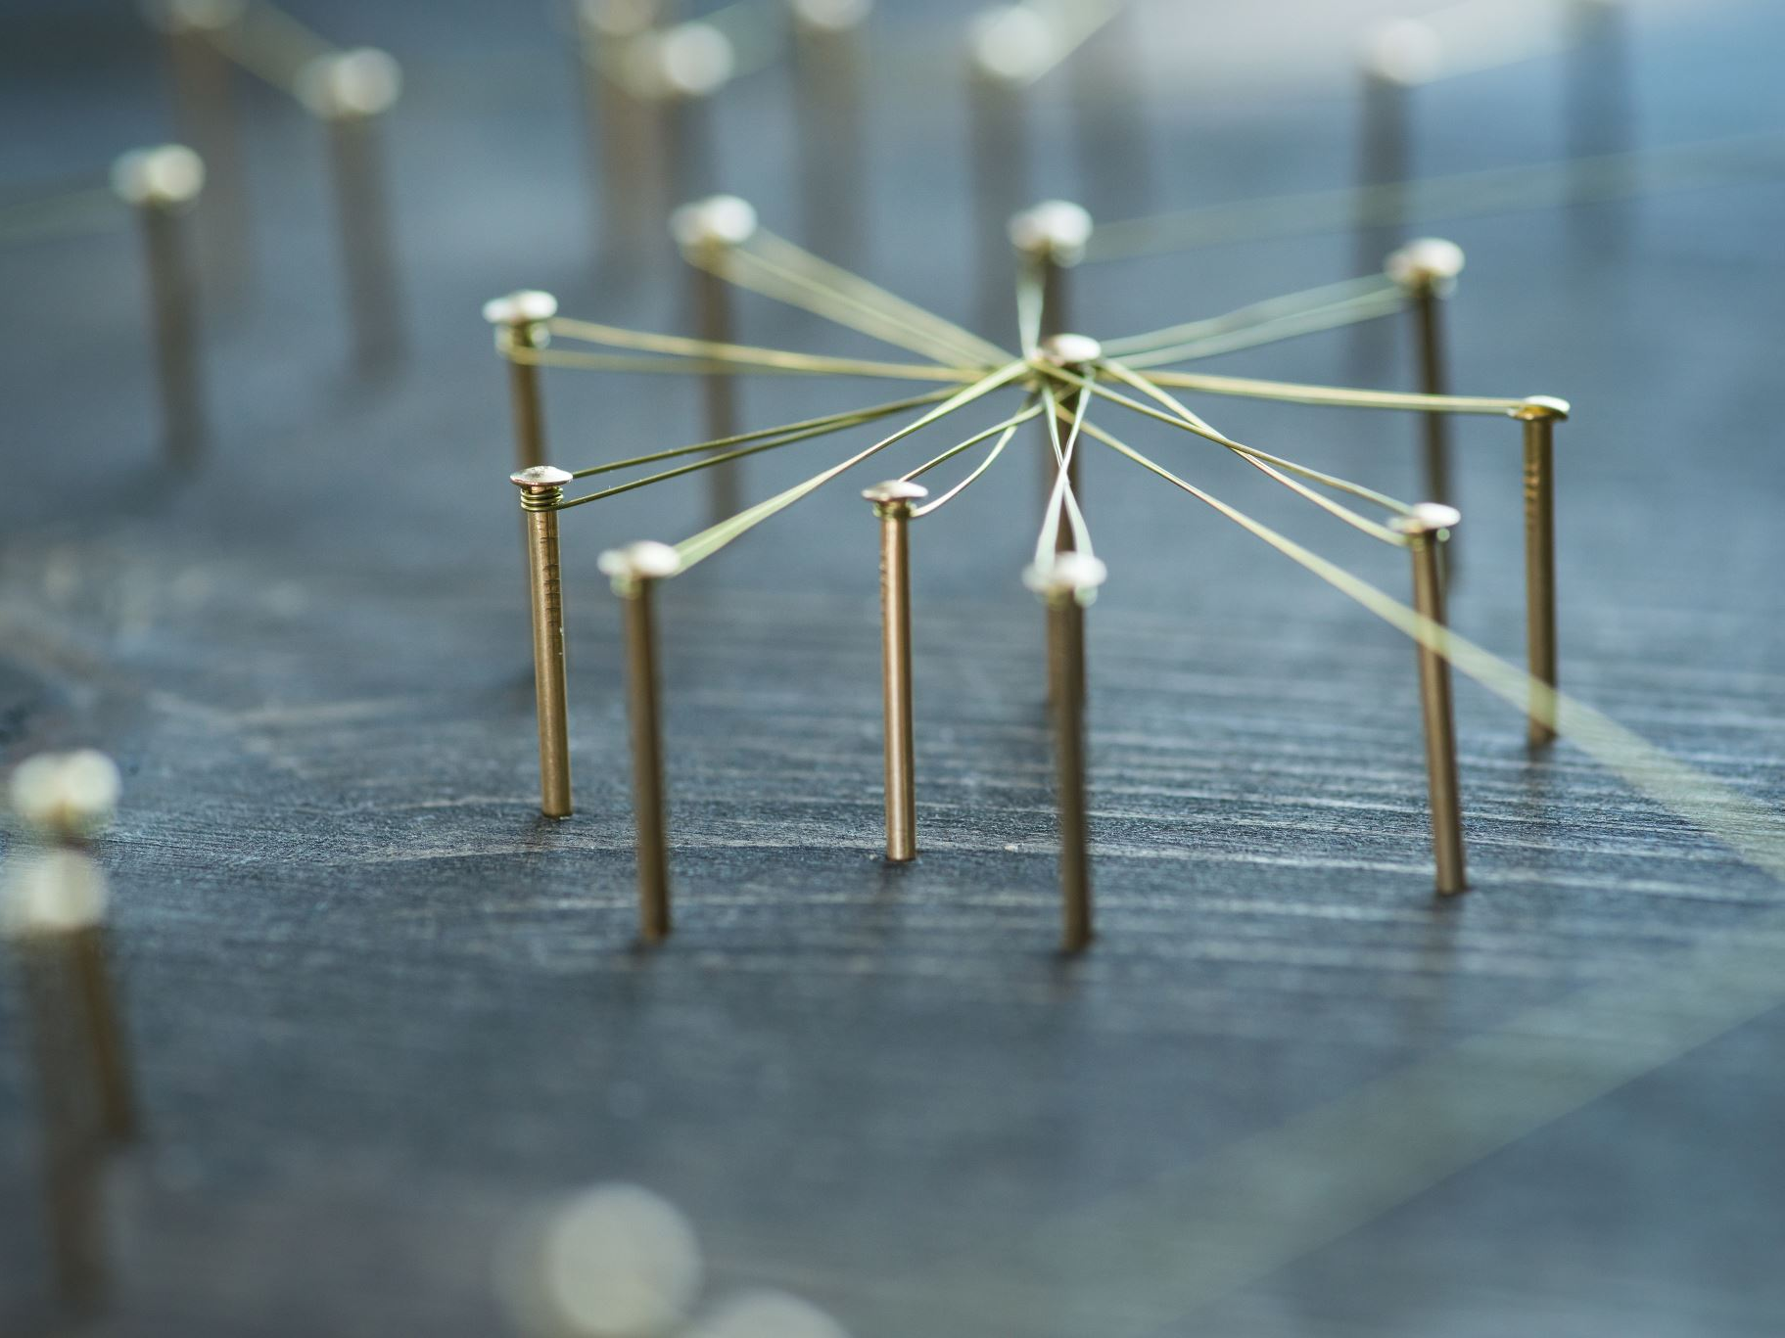
Discussion

Slide 20
Relationship of SWE and conventional ultrasound with age and laboratory tests.
YM measurements significantly correlated with age.
This was due to the development of glomerulosclerosis, interstitial fibrosis, tubular atrophy, and arteriosclerosis as kidneys aged.
Tubulointerstitial renal fibrosis, a progressive detrimental connective tissue deposition in the kidney parenchyma is the leading cause in renal function deterioration. Progressive interstitial damage results in declining GFR, indicating an inverse correlation between serum creatinine and GFR.
As the degree of fibrosis increases, the affected tissue area become stiffer, allowing shear waves generated by a transducer to propagate quickly.
The GFR was inversely related to the degree of renal fibrosis, which in turn is directly related to the propagation of shear waves.
Relationship of SWE measurement with eGFR grading.
SWE measurement was negatively correlated with eGFR grading
However, the mean YM measurement for CKD patients (eGFR 15–29) was lower compared with the eGFR 30–59 subgroup.
This discrepancy could be due to the small number of patients in eGFR 15–29 subgroup (n = 10),
As most of the patients in this subgroup had to be excluded due to thin renal parenchymal thickness compared with the eGFR 60–89 (n = 57) and eGFR 30–59 (n = 35) subgroups.
Notes:
Tubulointerstitial renal fibrosis, a progressive detrimental
connective tissue deposition in the kidney parenchyma, appeared
to be the leading cause in renal function deterioration. Progressive
interstitial damage results in declining GFR, indicating an
inverse correlation between serum creatinine and GFR.14 Hyperfiltration
may also cause interstitial damage at the glomerulus,
leading to tubulointerstitial injury as plasma proteins are forced
out into the tubule and urine.15 Protein reuptake at the tubules
may result in the development of inflammation and fibrosis. As
the degree of fibrosis increases, the affected tissue area becomes
stiffer, allowing shear waves generated by a transducer to propagate
quickly.16,17 The GFR was inversely related to the degree of
renal fibrosis, which in turn is directly related to the propagation
of shear waves. Our results concur with this, where YM measurements
significantly correlated with eGFR, and serum creatinine
and urea

Slide 21
Relationship of age-associated loss of kidney function and reduction in kidney size
No significant correlation between kidney length or cortical thickness with age
One explanation is prevalence of CKD did not increase with age but with other risk factors such as obesity, hypertension and diabetic nephropathy
Kidney length is not an accurate predictor of kidney abnormality as compared to kidney volume.
In this study it showed that conventional ultrasound had no correlation between kidney length or cortical thickness and laboratory tests.
Renal length and parenchymal thickness, when compared to SWE, have a weaker correlation with serum creatinine and eGFR.
YM measurement of less or equal to 4.31 kPa was determined as a diagnostic indicator of normally functioning renal parenchyma with a sensitivity of 80.3% and a specificity of 79.5%, superior to conventional ultrasound parameters.

Slide 22
Limitation of SWE | Literature | Study result
intra- and interobserver variation | - Good interobserver reliability - The intraobserver reliability obtained is higher than in published studies on renal stiffness measurements (ICCs was 0.709). - Possibly due to both operators in this study were more experienced in the field of ultrasonography as well as SWE imaging.
Bladder distention | - Sohn et al stated that increased pelvic pressure due to hydronephrosis could increase renal parenchymal stiffness. - Median SWVs in kidneys with high-grade hydronephrosis were higher than those in normal kidneys. | - No significant difference in the YM measurements between a distended bladder and empty bladder - could be due to the overly distended bladder causing only mild splaying of the pelvicalyceal system, but not hydronephrosis that may alter the stiffness of the renal parenchyma.
Location of ROI | - Kidney tissue is anisotropic - Sending ultrasound beams in different axes on these structures (loops of Henle and vasa recta within the medulla, collecting ducts within cortex and medulla) might lead to different elasticity values due to the difference in the way the shear waves propagate. | - significant difference in YM measurements when the position of the ROI was changed, effectively altering the beam-to-tissue orientation - a fixed location should be determined during image acquisition to obtain reliable and reproducible results, especially when establishing normal limits of stiffness of a particular tissue - Recommend placing the ROI box at the midregion of the kidney during image acquisition as this position easily allows exclusion of the renal medulla and sinus.
Notes:
Results of SWE is encouraging.
However, an overly-distended bladder with transmitted backpressure might give a
false positive for obstructive hydronephrosis It is known that kidney tissue is anisotropic, hence, the properties are not the same in all axis orientations.
Sending ultrasound beams in different axes on these structures (loops of Henle and vasa recta within the medulla, collecting ducts within cortex
and medulla) might lead to different elasticity values due to the difference in the way the shear waves propagate

Slide 23
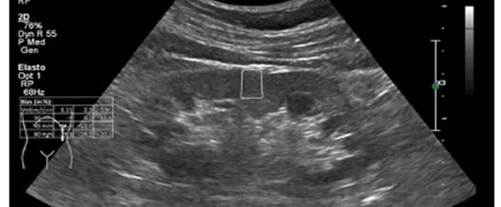
Conclusion
SWE was superior to conventional ultrasound in the assessment of CKD.
Cut-off value of 4.31 kPa to distinguish between diseased from normal kidneys.
Despite its limitations, SWE-derived estimates of renal stiffness is an effective, low-cost tool for non-invasive method to provide extra diagnostic information in CKD

